Slide 1
Data Analysis: Sales Prospects from Home Mortgage Data

Slide 2
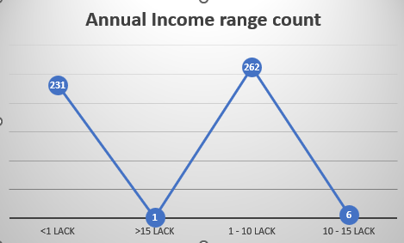
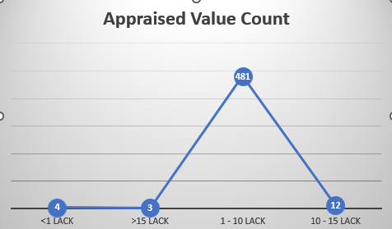

Slide 3
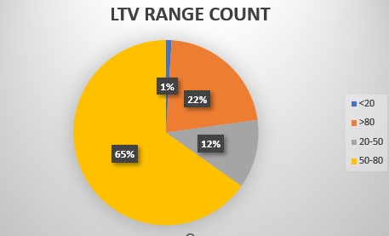
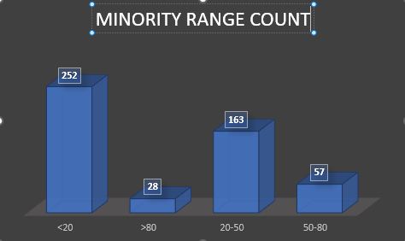

Slide 4
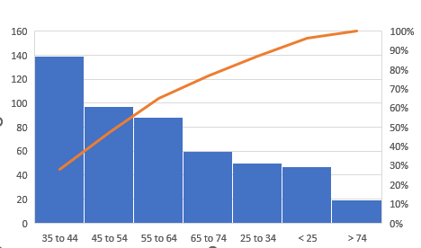
Age wise LTV ratio – Pareto chart

Slide 5
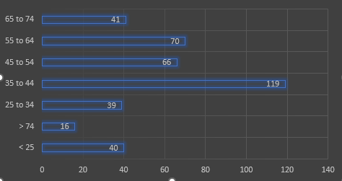
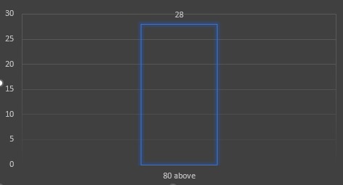
LTV Below 80
Minority count Above 80

Slide 6
Observations and Key Insights
Above 50% of people had 1 to 10 lack Annual income range
28 people had Minority range above 80%
Above 50% of people belongs to below 20 Minority range
Most of people had 1 to 10 lack Apraised range
Most of people are Above 50 LTV range
27% people belongs to 35-44 age group in LTV ratio

